Slide 1
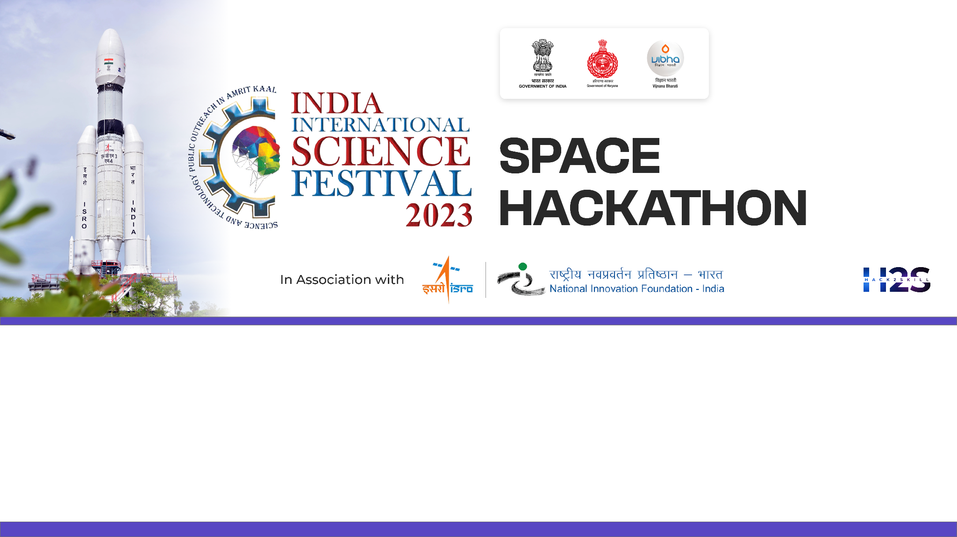

Team Name: Geo-Extractors
Name of College/University: Andhra University College Of Engineering
Team Member Details:
BANDI JAYASATYADURGARAO
JAGU MANISH
GAUTAM KUMAR KUSHWAHA
CHATTI VENKATA RAVITEJA

Slide 2

Problem Statement: Feature Extraction from RS‐HR data using AIML
MOTIVATION:
The challenge in remote sensing lies in extracting vital features like Farm Pond, Check Dam, Nala Pond, Dug Wells, High Tension Tower, Windmill, etc.. from HR-Satellite images.
For applications such as utility management & planning, water resource management, renewable energy, etc.
Manual identification is error-prone (Human expert decision-based errors), Laborious, and time-consuming.
To create a feature extraction knowledge engine, by incorporating hybrid ML, DL, and CNN models.
BACKGROUND:
Advanced automated analysis of satellite imagery across varied environments for diverse applications.
Customized labeled Datasets for multiple features.
Adaptability to New Feature Types
Extensive Generalization
OUR SOLUTION:
Automatic Feature extraction model with a state-of-the-art multi-label classification system that delivers precision through bounding boxes or masks, and confidence scores for each identified feature.
Class-wise labels are generated by taking ground validation data, employing various Image segmentation techniques to label distinct features, complemented by applying diverse OBIA classification methods through Deep neural networks(CNN).
Creating an Automated multi-label classification model entails initial training with diverse datasets, followed by retraining using meticulously crafted labeled datasets that cover various features. The model then outputs bounding boxes for each detected feature, accompanied by corresponding confidence scores.
Using Data augmentation Techniques to make the model robust and accurate for satellite imagery.

Slide 3
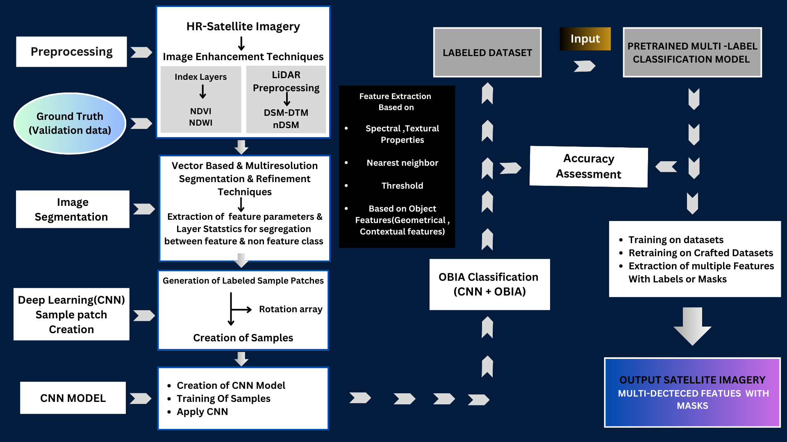
DETAILED METHODOLOGY

Slide 4
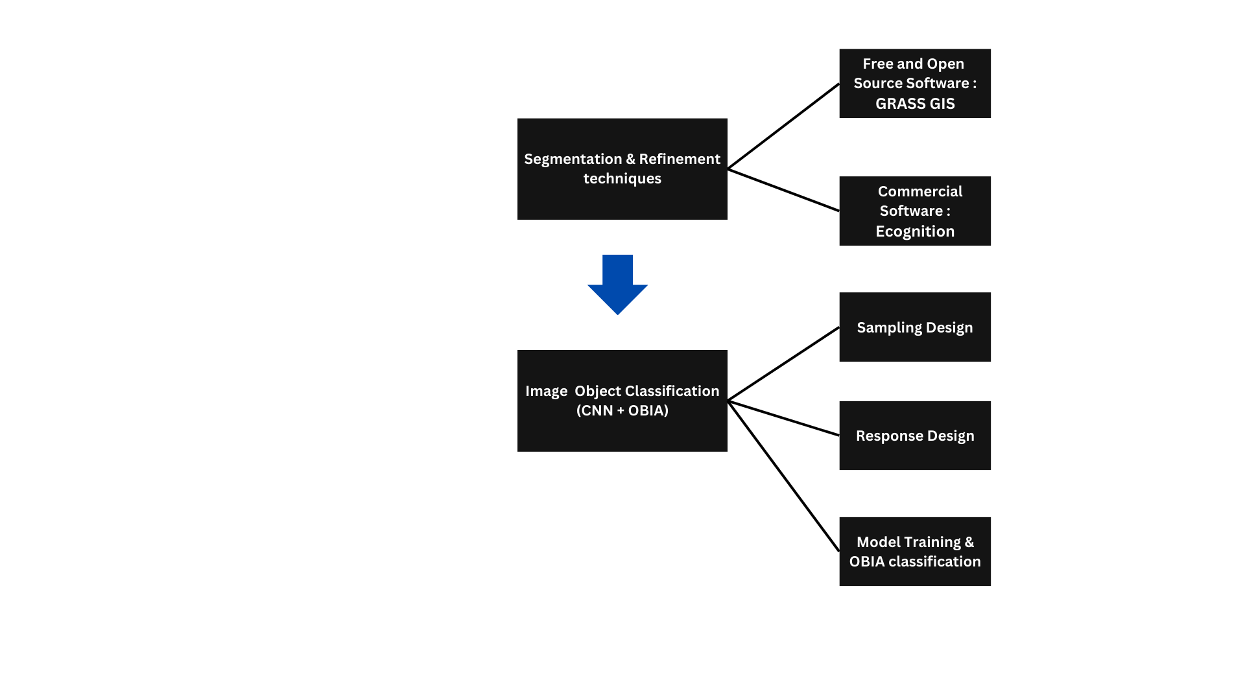
Detailed Proposal & Solution Approach
Preprocess Satellite Imagery and ancillary data : By applying corrections, individual image bands generate index layers (NDVI, NDWI) and ancillary data (nDSM). nDSM with pixel values represents above-ground object heights, aiding in object isolation for segmentation or classification.
Extraction of CNN Training patches that enclose or are within Training segments.
In CNN Model Training, CNN Model inference on patches that enclose or are within Segments.
Segment Classification based on class of Corresponding Patch.

Slide 5
Tools and devices used on development
eCognition
GRASS GIS
QGIS
ERDAS IMAGINE
OpenCV
PyTorch
TensorFlow
Jupyter Notebook
Technologies involved/used:
GIS(Geographic Information System)
Remote Sensing
Digital Image Processing
AI/ML/DL(CNN)
OBIA (Object Based Image Analysis)
LiDAR Imaging
References/Acknowledgement
Kucharczyk, M., Hay, G. J., Ghaffarian, S., & Hugenholtz, C. H. (2020). Geographic Object-Based Image Analysis: A Primer and future directions. Remote Sensing, 12(12), 2012. https://doi.org/10.3390/rs12122012

